Slide 1
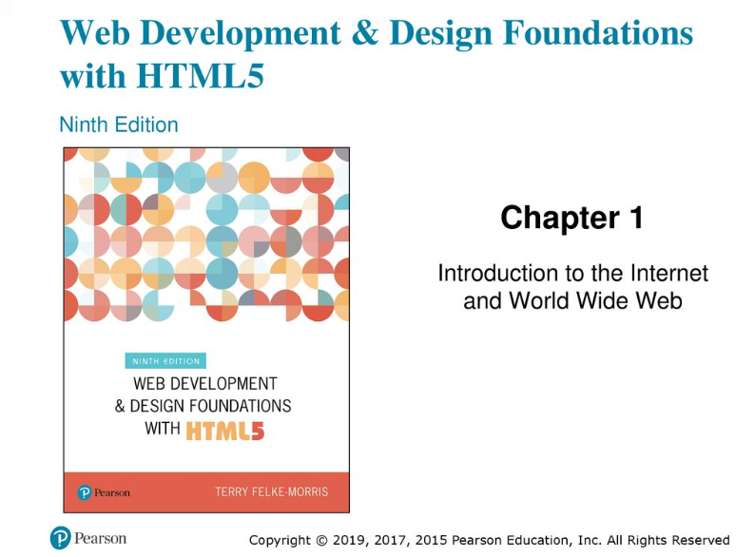

Slide 2
Learning Outcomes
Describe the evolution of the Internet and the Web
Explain the need for web standards
Describe universal design
Identify benefits of accessible web design
Identify reliable resources of information on the Web
Identify ethical use of the Web
Describe the purpose of web browsers and web servers
Identify Internet protocols
Define URIs and domain names
Describe XHTML and HTML5
Create your first web page
Use the body, head, title and meta elements
Name, save, and test a web page

Slide 3
The Evolution of the Internet
Internet
Interconnected network of computer networks
ARPAnet
Advanced Research Project Agency
1969 – four computers connected
NSFnet
National Science Foundation
Use of the Internet was originally limited to government, research and academic use
1991 Commercial ban lifted

Slide 4

The World Wide Web
The graphical user interface to information stored on some of the computers connected to the Internet.

Slide 5
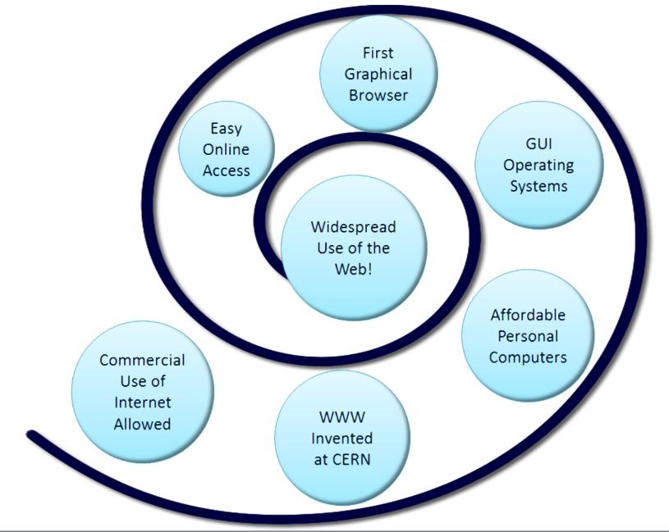
Convergence of Technologies

Slide 6
Convergence of Technologies
Removal of the ban on commercial activity
Development of the World Wide Web at CERN
Development of Mosaic, the first graphics-based web browser at NCSA
Affordable personal computers with GUI operating systems
Affordable Internet Service Providers

Slide 7
Web Standards and the W3C Consortium
W3C – World Wide Web Consortium
Develops recommendations and prototype technologies related to the Web
Produces specifications, called Recommendations, in an effort to standardize web technologies
WAI – Web Accessibility Initiative

Slide 8
Web Accessibility
“The power of the Web is in its universality. Access by everyone regardless of disability is an essential aspect.” – Tim Berners-Lee
Accessible Websites provide accommodations that help individuals to individuals with visual, auditory, physical, and neurological disabilities overcome barriers
WAI – Web Accessibility Initiative
Develops accessibility recommendations
WCAG 2.0
Web Content Accessibility Guidelines http://www.w3.org/WAI/WCAG20/quickref/

Slide 9
Web Accessibility
Section 508 of the Rehabilitation Act
Requires that government agencies must give individuals with disabilities access to information technology that is comparable to the access available to others

Slide 10
Universal Design
“The design of products and environments to be usable by all people, to the greatest extent possible, without the need for adaptation or specialized design.” – The Center for Universal Design http://www.design.ncsu.edu/cud/about_ud/about_ud.htm

Slide 11
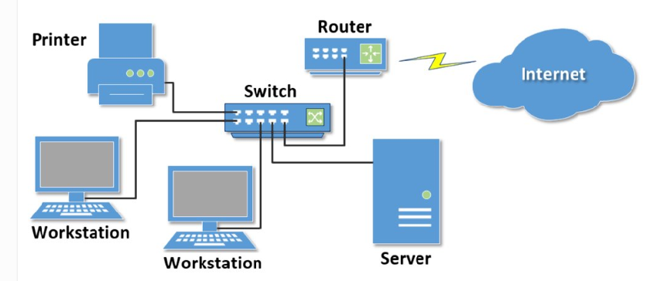
Network Overview
Network two or more computers connected together for the purpose of communicating and sharing resources

Slide 12
The Client/Server Model
Client/Server can describe a relationship between two computer programs – the "client" and the "server".
Client
requests some type of service (such as a file or database access) from the server.
Server
fulfills the request and transmits the results to the client over a network

Slide 13
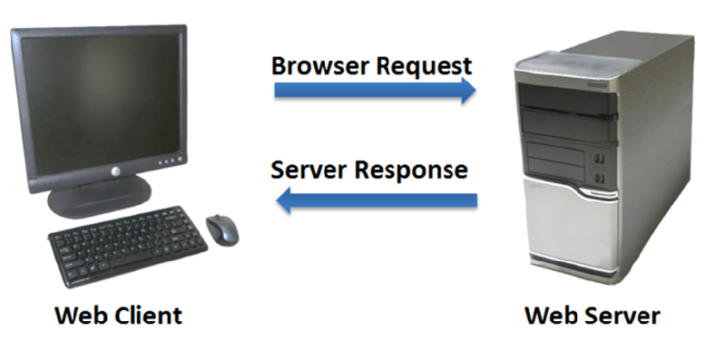
The Client/Server Model
The Internet Client/Server Model
Client: Web Browser
Server: Web Server

Slide 14
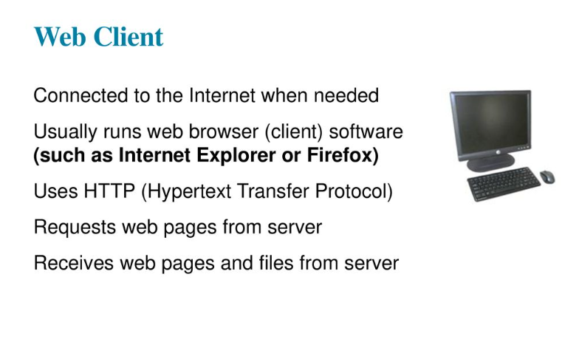

Slide 15
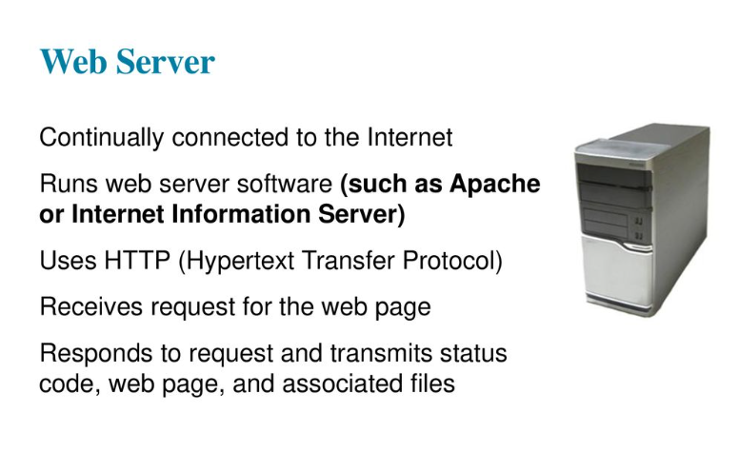

Slide 16
Internet Protocols
Protocols
Rules that describe the methods used for clients and servers to communicate with each other over a network.
There is no single protocol that makes the Internet and Web work.
A number of protocols with specific functions are needed.

Slide 17
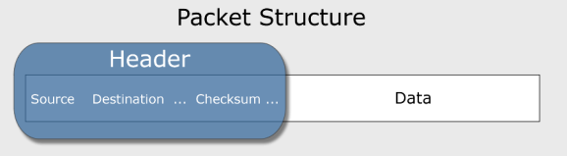
Common Internet Protocols
Official Communication Protocol: TCP/IP
Specialized Protocols:
File Transfer: FTP
E-mail: SMTP, POP3, IMAP
Websites: HTTP

Slide 18
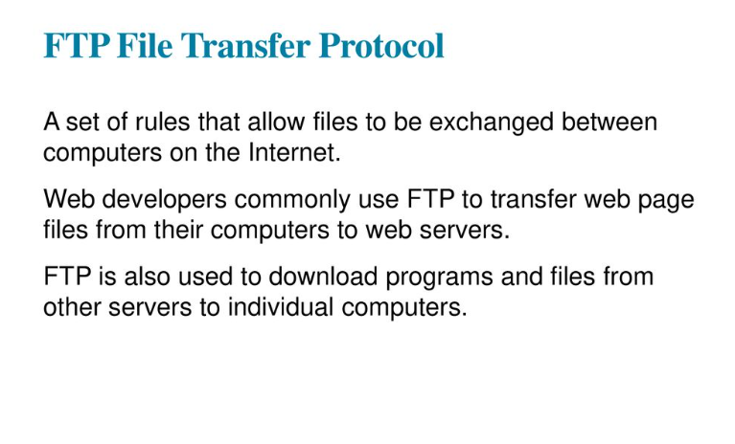

Slide 19
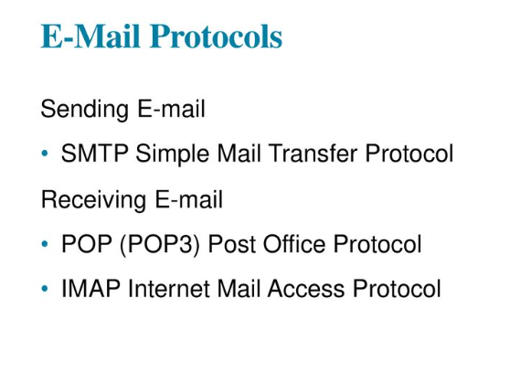

Slide 20
HTTP Hypertext Transfer Protocol
A set of rules for exchanging files such as text, graphic images, sound, video, and other multimedia files on the Web.
Web browsers send HTTP requests for web pages and their associated files.
Web servers send HTTP responses back to the web browsers.
HTTP Request
HTTP Response

Slide 21
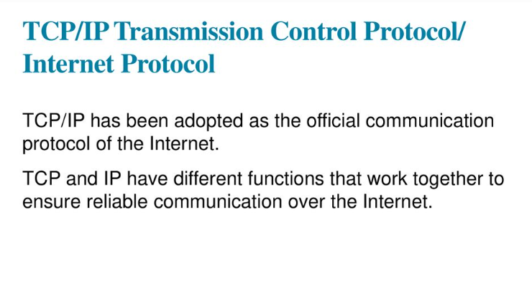

Slide 22
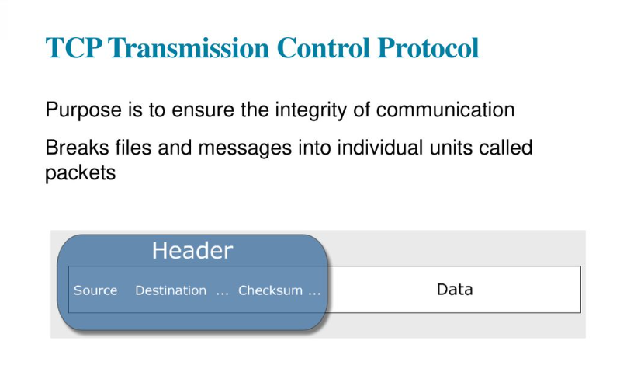

Slide 23
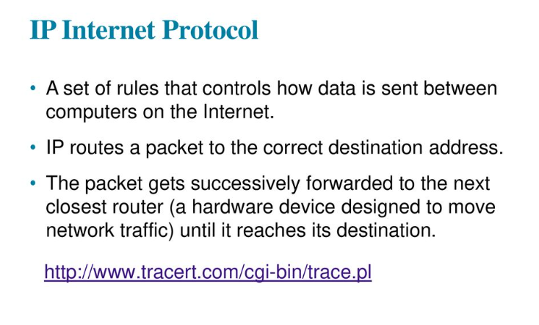

Slide 24
IP Address
Each device connected to the Internet has a unique numeric IP address.
These addresses consist of a set of four groups of numbers, called octets. 74.125.73.106 will get you Google!
An IP address may correspond to a domain name.

Slide 25
Domain Name
Locates an organization or other entity on the Internet
Domain Name System
Divides the Internet into logical groups and understandable names
Associates unique computer IP Addresses with the text-based domain names you type into a web browser
Browser: http://google.com
IP Address: 74.125.73.106

Slide 26
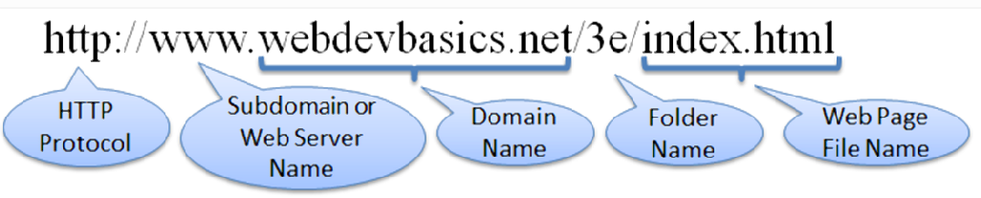
URI Uniform Resource Indicator
URL Uniform Resource Locator
Represents the address of a resource on the Internet.

Slide 27
TLD Top-Level Domain Name
A top-level domain (TLD) identifies the right-most part of the domain name.
Some generic TLDs: .com, .org, .net, .mil, .gov, .edu, .int, .aero, .asia, .cat, .jobs, .name, .biz, .museum, .info, .coop, .pro, .travel

Slide 28
NEW gTLDs!
ICANN accepted proposals for almost 2000 new gTLDs in 2012.
A wide variety of new gTLDs were proposed
Some of the first new gTLDs to become available included .bike, .guru, .holdings, .clothing, .singles, .ventures, and .plumbing.
ICANN has set a schedule to periodically launch new gTLDs.
Visit http://newgtlds.icann.org/en/program-status/delegated-strings for a list of new gTLDs.

Slide 29
County Code TLDs
Two character codes originally intended to indicate the geographical location (country) of the web site.
In practice, it is fairly easy to obtain a domain name with a country code TLD that is not local to the registrant.
Examples:
.tv, .ws, .au, .jp, .uk
See http://www.iana.org/domains/root/db for a list of TLDs.

Slide 30
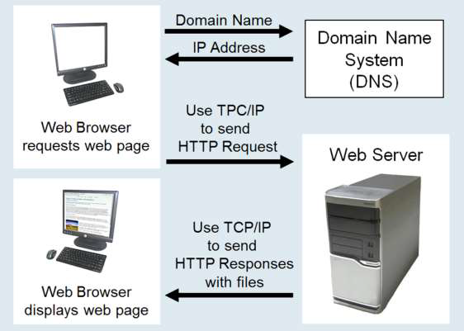
Domain Name System
The Domain Name System (DNS) associates Domain Names with IP addresses.

Slide 31
Markup Languages
SGML – Standard Generalized Markup Language
A standard for specifying a markup language or tag set
HTML – Hypertext Markup Language
The set of markup symbols or codes placed in a file intended for display on a web browser.
Element or tag – individual markup code
Attribute – modifies the purpose of a tag

Slide 32
Markup Languages (2)
XML – eXtensible Markup Language
A text-based language designed to describe, deliver, and exchange structured information.
It is not intended to replace HTML – it is intended to extend the power of HTML by separating data from presentation.

Slide 33
Markup Languages (3)
XHTML – eXtensible Hypertext Markup Language
Developed by the W3C as the reformulation of HTML 4.0 as an application of XML.
It combines the formatting strengths of HTML 4.0 and the data structure and extensibility strengths of XML.

Slide 34

Markup Languages (4)
HTML 5
The next version of HTML 4 and XHTML 1
Incorporates features of both HTML and XHTML
Adds new elements
Eliminates some elements
Intended to be backward compatible
http://www.w3.org/html/

Slide 35
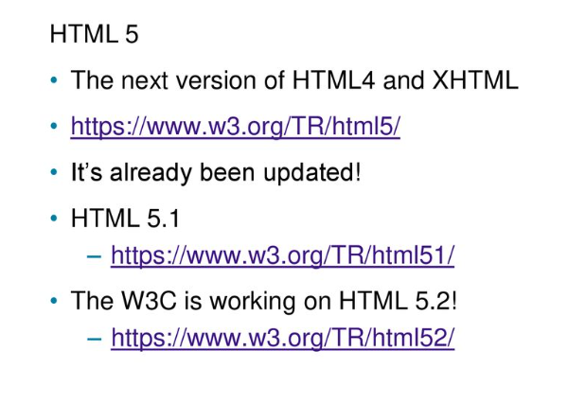

Slide 36
Your First HTML5 Web Page: index.html
<!DOCTYPE html">
<html lang="en">
<head>
<title>Page Title Goes Here</title>
<meta charset="utf-8">
</head>
<body>
... body text and more HTML tags go here ...
</body>
</html>

Slide 37
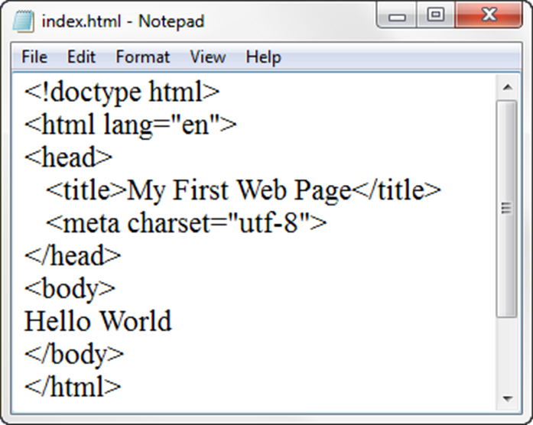
Under the Hood of a Web Page
DTD – describes the markup language syntax
HTML element– contains the web page document
Head element – contains the head section The head section contains information that describes the
web page document
Title element– Text displays in title bar of window
Meta element – describes the character encoding
Body element – contains the body section
The body section contains the text and elements that display in the browser viewport.

Slide 38
Document Type Definition (DTD)
A document type definition (DTD) is a set of markup declarations that define a document type for an SGML-family markup language (SGML, XML, HTML).
A Document Type Definition (DTD) defines the legal building blocks of an XML document.
It defines the document structure with a list of legal elements and attributes
HTML5 don’t use DTD, it makes use of stylesheet

Slide 39
Summary
This chapter provided a brief overview of Internet, Web, and introductory networking concepts along with your very first web page.

